Slide 1

Vel Tech Rangarajan Dr. Sagunthala R&D Institute of Science and Technology
School of Computing
Department of Computer Science and Engineering
10211CS224 / FULL STACK APPLICATION DEVELOPMENT (JAVA)
PROJECT REVIEW : MILESTONE PROJECT – 1
Date: 23-03-2026
REAL TIME EVENT SYNCHRONIZATION ENGINE
SDG: 4 Quality Education
Presented By:
N. SAI VIGNESH –VTU25573-23UECS0828
Courses Handling Faculty:
Dr.S.HEMAMALINI-M.E,Ph.D.,

Slide 2
INTRODUCTION
1
In modern academic environments, students and faculty often interact with shared event data such as workshops, seminars, and campus activities. Ensuring real-time updates is essential for effective communication and coordination. Traditional systems require users to manually refresh pages to view the latest event information, which can lead to delays, missed updates, and confusion.
This project, Academic Campus Event & Registration Portal, addresses this issue by providing a platform where event updates are instantly reflected across all users. Whenever an event is created, updated, or deleted, the changes are automatically synchronized in real time. This allows students and staff to stay informed about upcoming events, registration status, and important announcements without any delay.
The system improves collaboration, enhances user experience, and ensures efficient event management within the campus. It is especially useful for managing academic events, student registrations, and notifications in a centralized platform. The application is developed using technologies such as Node.js, Express.js, and MongoDB to efficiently handle and synchronize event data.
2
3
4
5
6
7
8
9

Slide 3
PROBLEM STATEMENT
1
Many existing campus event management systems do not provide real-time updates when multiple users access or modify event information.
Students and faculty often need to manually refresh the page to view the latest updates.
This results in delays and inconsistent event information across different users.
Managing academic events such as workshops, seminars, and registrations becomes difficult without instant synchronization.
The lack of real-time communication reduces coordination and collaboration among students, organizers, and faculty.
It may also lead to issues like duplicate registrations or outdated event details when multiple users interact with the system simultaneously.
Therefore, there is a need for a system that automatically synchronizes campus event updates in real time.
The Academic Campus Event & Registration Portal addresses this problem by ensuring instant updates, improved data consistency, and efficient event management.
2
3
4
5
6
7
8
9

Slide 4
OBJECTIVE(S)
1
To design and develop an Academic Campus Event & Registration Portal that enables students, faculty, and organizers to create, update, and manage campus events efficiently.
To implement real-time data synchronization so that all event updates (such as event details, schedules, and registrations) are instantly reflected across all users without requiring page refresh.
2
3
4
5
6
7
8
9

Slide 5
PROPOSED SYSTEM
The system provides a real-time platform where students, faculty, and event organizers can create, update, and manage campus events and registrations simultaneously.
It uses real-time communication (such as WebSocket-based technology) to instantly synchronize event data between the server and all connected users.
Whenever an event or registration detail is modified by one user, the update is automatically reflected to all other users in real time.
The system securely stores event and registration data in a database to ensure consistency, accuracy, and reliability.
This solution eliminates the need for manual page refresh to view the latest event updates.
It enhances collaboration by ensuring that all users have access to up-to-date information about campus events and registrations.
The system reduces issues such as duplicate registrations and outdated event details when multiple users interact simultaneously.
Compared to traditional systems, it offers faster updates, improved efficiency, and a better user experience in managing academic events.
1
2
3
4
5
6
7
8
9

Slide 6
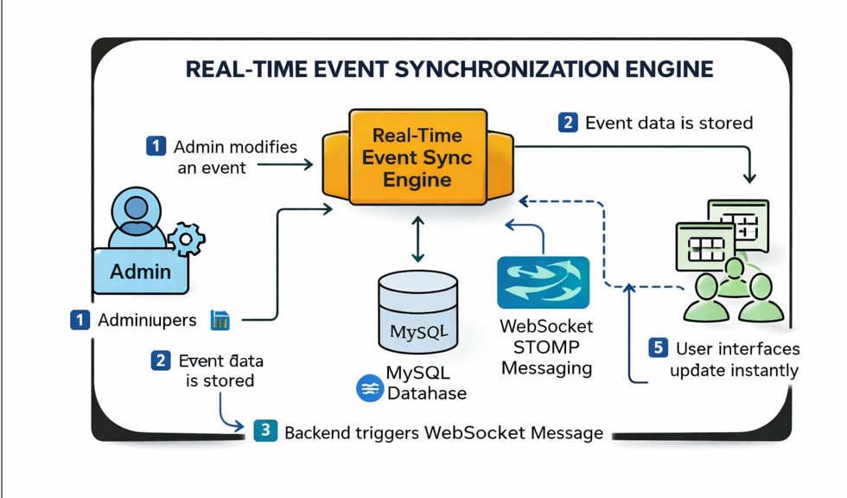
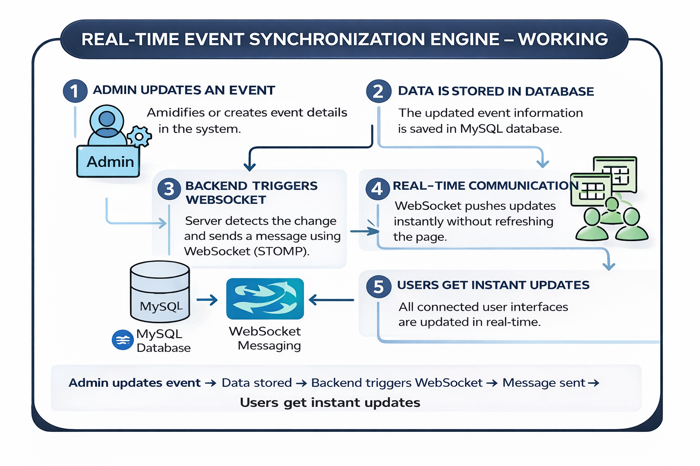
(Insert block diagram) -
Explain:
Input
Processing
Database
Output
PROPOSED SYSTEM ARCHITECTURE
1
2
3
4
5
6
7
8
9

Slide 7
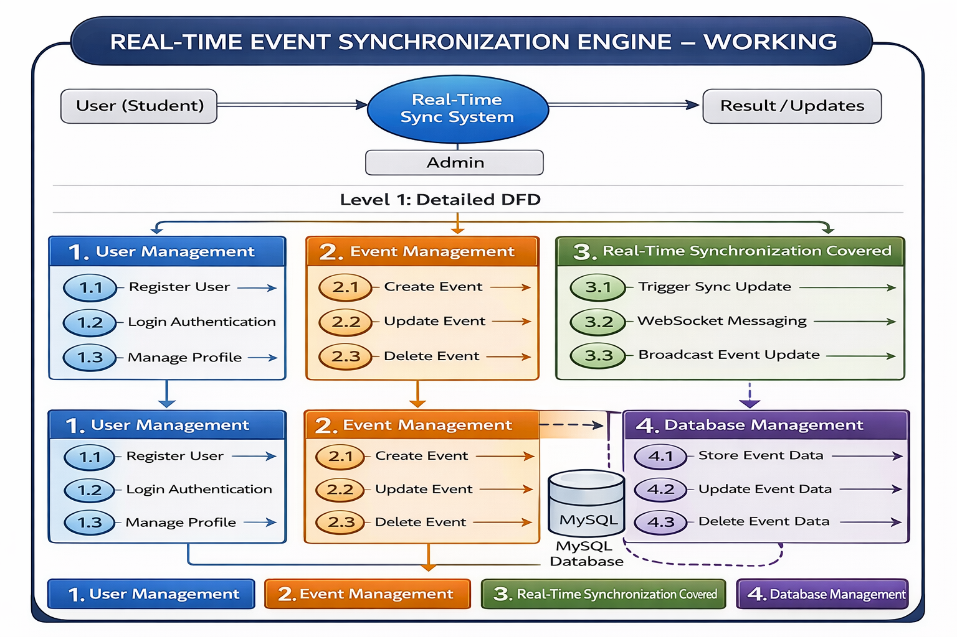
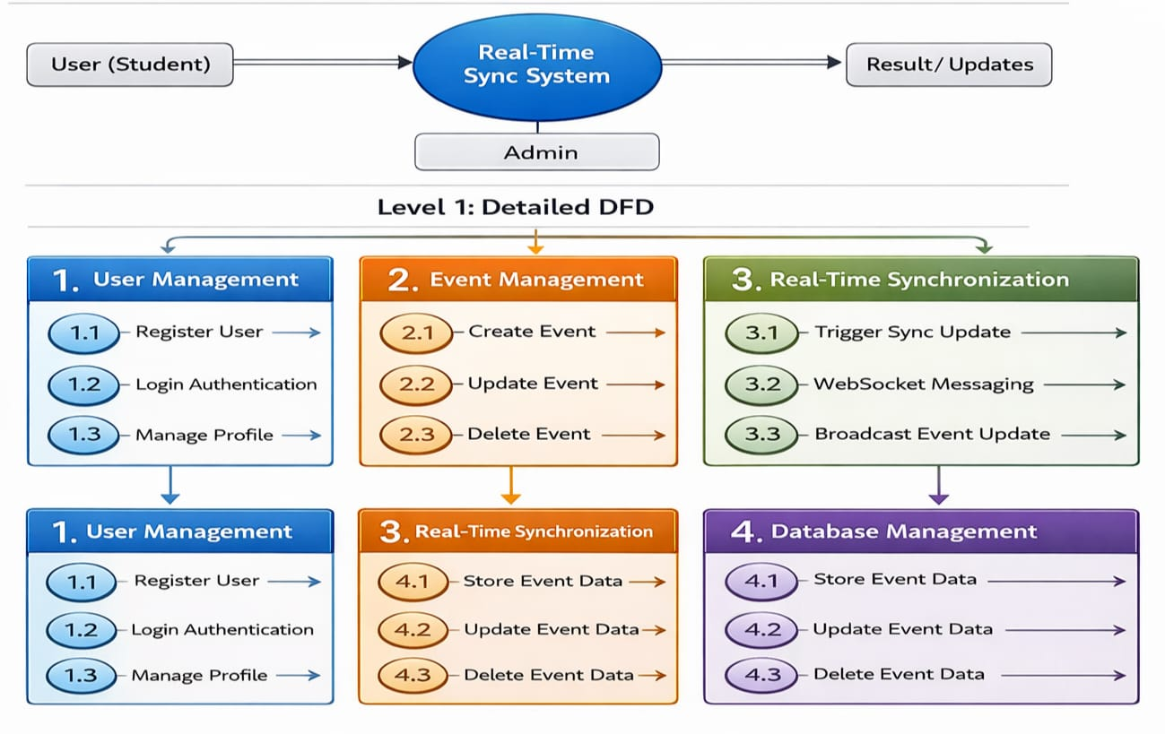
WORKFLOW
1
2
3
4
5
6
7
8
9

Slide 8
TECHNOLOGIES USED
Frontend:
1 . HTML5
2 . CSS3
3 . JavaScript
Backend:
1 . Node.js
2 . MySQL
3 . Express.js
Tools:
1 . XAMPP Server
2 . Visual Studio Code
Software Requirements:
1 . Windows
2 . Web Browser
1
2
3
4
5
6
7
8
9

Slide 9
MODULE DESCRIPTION
Module 1: User Management
Handles user registration, login, and authentication for students, faculty, and administrators.
Module 2: Event & Registration Management
Allows creation, update, deletion of events and enables users to view and register for events.
Module 3: Real-Time Synchronization Module
Ensures instant updates of event and registration data across all users without page refresh.
Module 4: Database Management
Stores and manages user, event, and registration data securely with consistency.
1
2
3
4
5
6
7
8
9

Slide 10
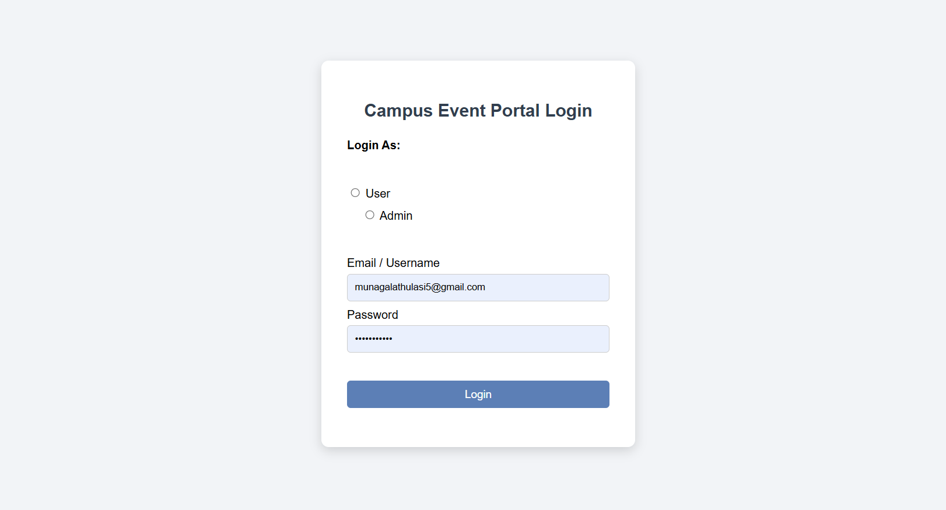
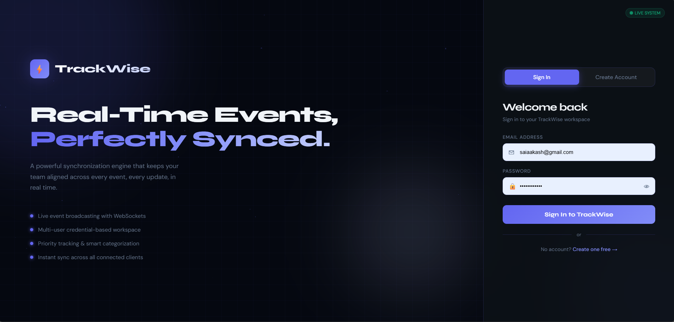
IMPLEMENTATION SCREENSHOTS
1
2
3
4
5
6
7
8
9

Slide 11
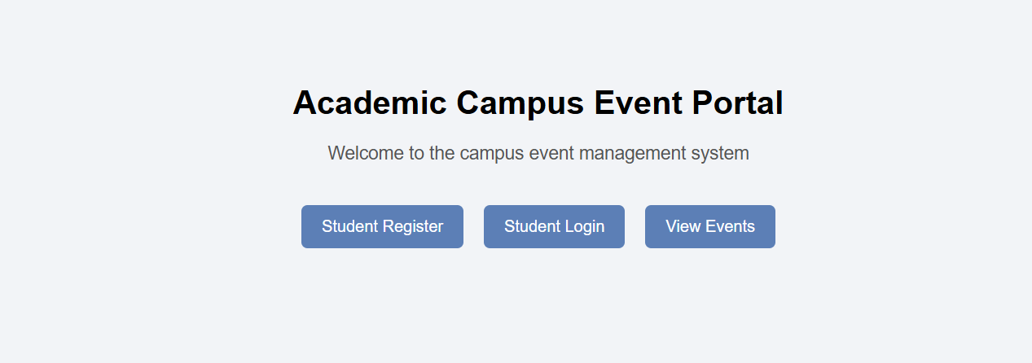
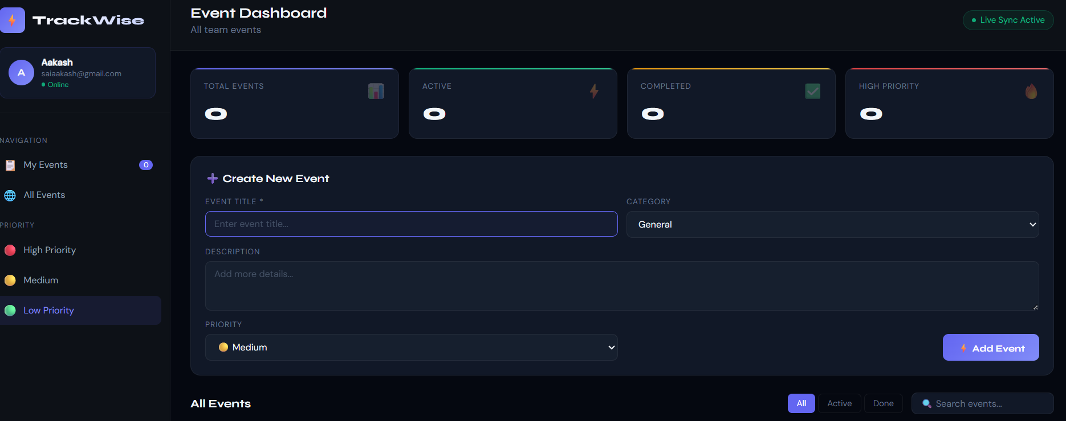
IMPLEMENTATION SCREENSHOTS
1
2
3
4
5
6
7
8(A)
9

Slide 12
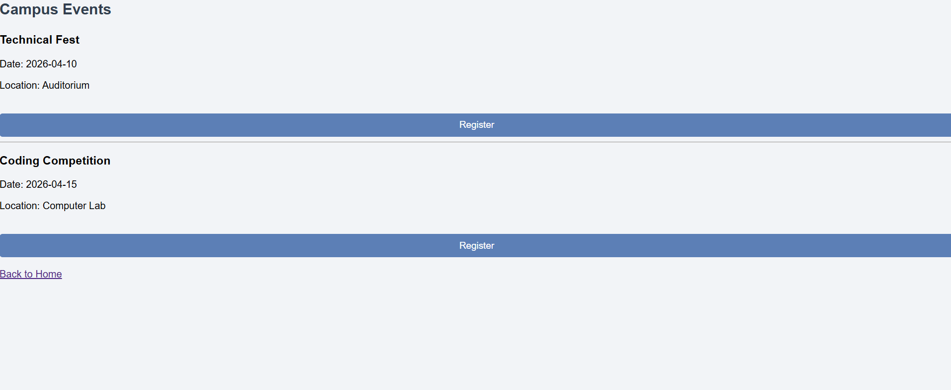
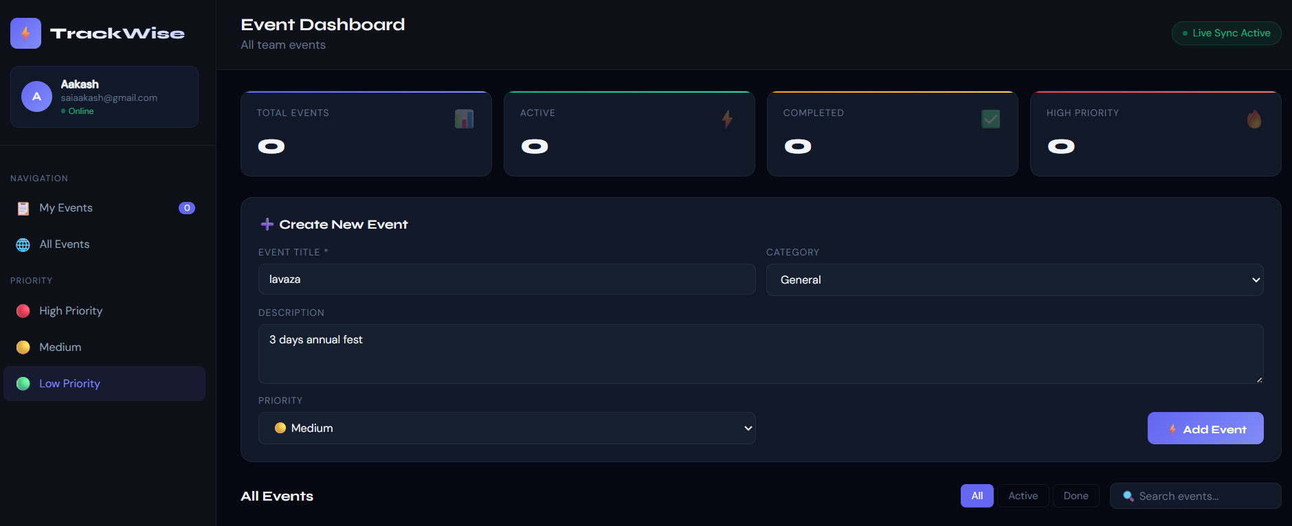
IMPLEMENTATION SCREENSHOTS
1
2
3
4
5
6
7
8(B)
9

Slide 13
ADVANTAGES & LIMITATIONS
1
Advantages:
Instant event updates in real-time.
No need for manual page refresh.
Prevents scheduling conflicts.
Improved user experience.
Scalable system for large users.
Limitations:
Requires a stable internet connection.
WebSocket configuration is complex.
Security challenges in real-time systems.
High server load handling required.
2
3
4
5
6
7
8
9

Slide 14
Thank you

